Slide 1
Deep Learning Visual E-Commerce Recommender
Team Royals
By: Wayne Nguyen, Hongcheng Jiang,
Fei Wu, and Zhaobin Zhang
GitHub: https://github.com/waynenguyen303/deep-learning-visual-eCommerce

Slide 2
Project Goal and Objectives
To improve and refine our initial project objectives, making a full working application was not advised at this time. Instead, an emphasis on the fashion data set should be a priority. In the world of big data, it is only as good as its data sets (garbage in, garbage out). For this increment, we want to focus on collecting staged images of the fashion item and categorize it accordingly. This is to help establish a baseline for accuracy of the implemented machine learning / deep learning algorithms. By using just staged images, we can also get a ball park range of our implemented algorithms time efficiency. Since the end goal is to give recommendations to the user, the application should not exceed a certain time threshold. If it takes too long, this can make the user not use the application. Further on, we would want to incorporate ‘live’ images of the fashion item.

Slide 3
1. INTRODUCTION
A broad use case is to have the user import any image and have our application recommend the fashion item of interest. This of course is a huge problem to tackle. A better starting scenario is to test staged or cataloged images. The fashion item image should be centered, in high definition, and formatted to a certain size. There should be no to little background noise in the image. With this, we would run a three-stage classifier module on the item. The first stage is a deep learning algorithm to classify what the item is. Second, a machine learning algorithm (Clarifai) to classify its design elements and features. The third stage would be a logo recognizer algorithm to see if there is any logos attached to the fashion item. Once the module is done, the image is now correctly tagged with what the item is (watch), what details it has (silver with diamonds), and what brand (Rolex). This tag can then be run through a knowledge recommendation algorithm to show the user where to buy that or a similar item.

Slide 4
2. RELATED WORKS
TensorFlow-for-poets: https://codelabs.developers.google.com/codelabs/tensorflow-for-poets/
Docker: https://www.docker.com/
Clarifai: https://www.clarifai.com/
Given shallow learning algorithms (class spreadsheet): https://docs.google.com/spreadsheets/d/1TkZalFcjQ8MCWLdkQkTdEhUYG5V8hsUF4KzMNmy_Rto/edit?ts=5a5e212f#gid=742202525

Slide 5
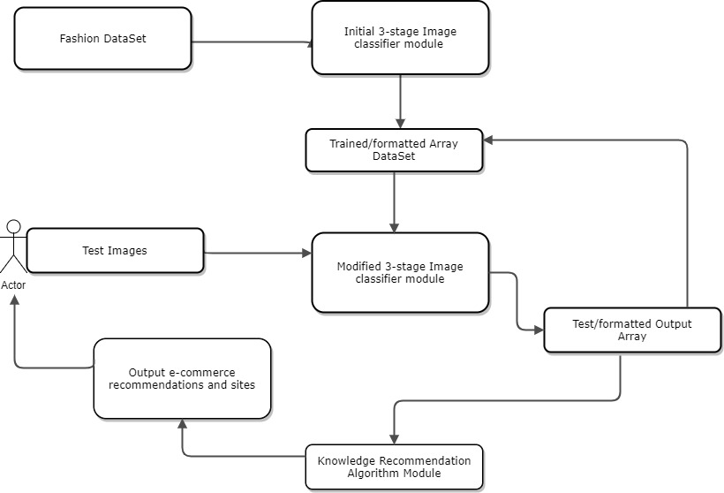
3. Recommender System.

Slide 6
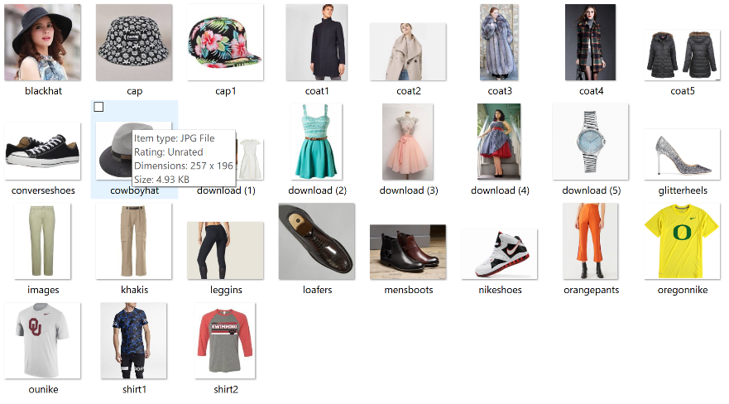
4. Data set
Initial data set
Broad focus on online apparel
9 Categories: hats, shoes, suits, Adidas, coats, pants, dresses, shirts, and watches.
Catalog, live, and multi-category images. ~100 images per category for training and testing.
Algorithm accuracies were very low due to the similarity of categories and diversity of images.

Slide 7
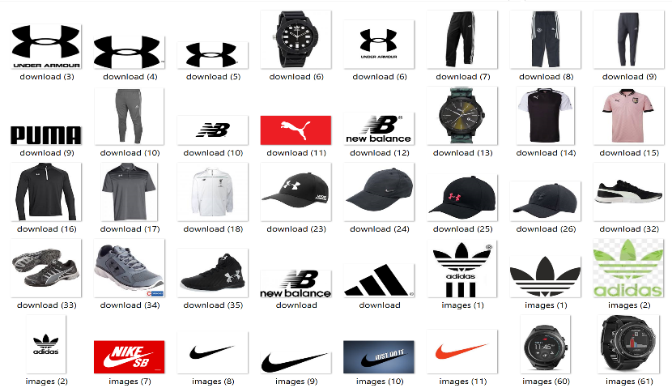
Continue
Revised data set
Focus on sports apparel and logos
5 categories each: hats, bottoms, tops, shoes, watches, Nike logo, Adidas logo, Puma logo, New Balance logo, and Under Armor logo.
Categories chosen for maximum differentiation. Coats and shirts were too similar.
Catalog style images only with little to no background noise.
~ 100 images per category for training and testing. This number needs to be increased but proving difficult without duplication of images.

Slide 8
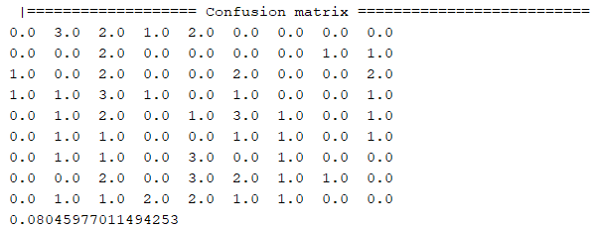
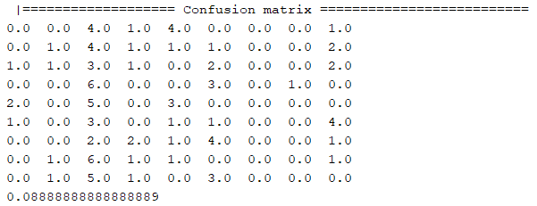
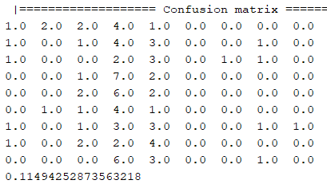
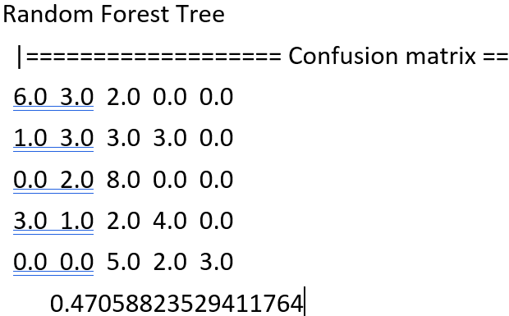
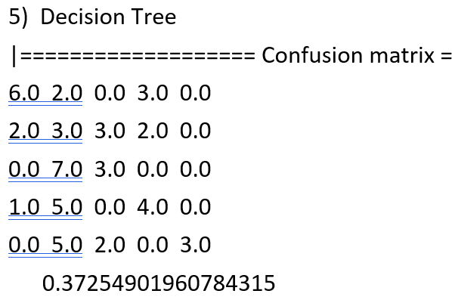
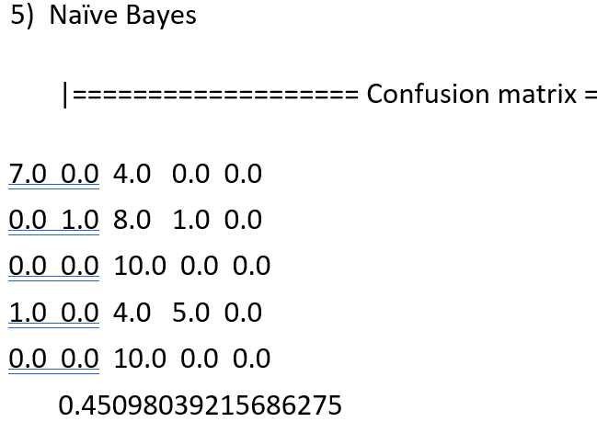
5. Shallow Learning Classification
Using the Adobe Spark library, classification models were made with Naïve Bayes, Decision Tree, and Random Forest algorithms.
On initial data set, accuracy was too low for all 3 algorithms.
Random Forest Decision Tree Naïve Bayes
On revised data set, accuracy was much improved but still needs to be at a higher rate. Need more training and testing images.

Slide 9
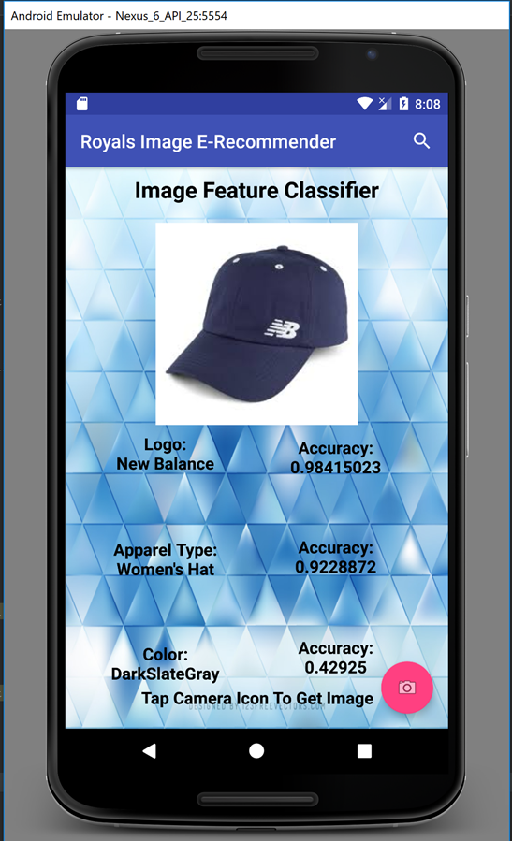
Recommendation System

Slide 10
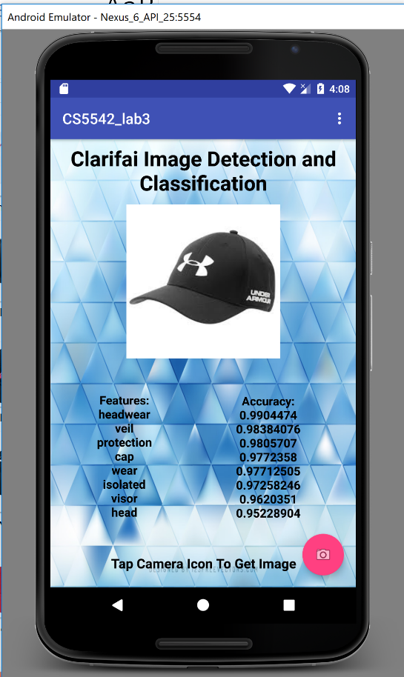
Clarifai ML Object Detection
Using the Clarifai API and its machine learning algorithm, objects on the image can be recognized and have its accuracy rating.
This can somewhat reinforce the shallow learning
classification since Clarifai’s accuracy of detected
objects is very good.
We would like to also utilize Clarifai’s logo
recognition algorithm, but some refinement in the
code needs to be done to use that API.
A windfall of this API is that if there is a lot of
noise in the image, it tends to detect any and all
objects and send back the highest accuracy first.
More than likely, we will use this particular API as
an object descriptor for our recommendation system.

Slide 11
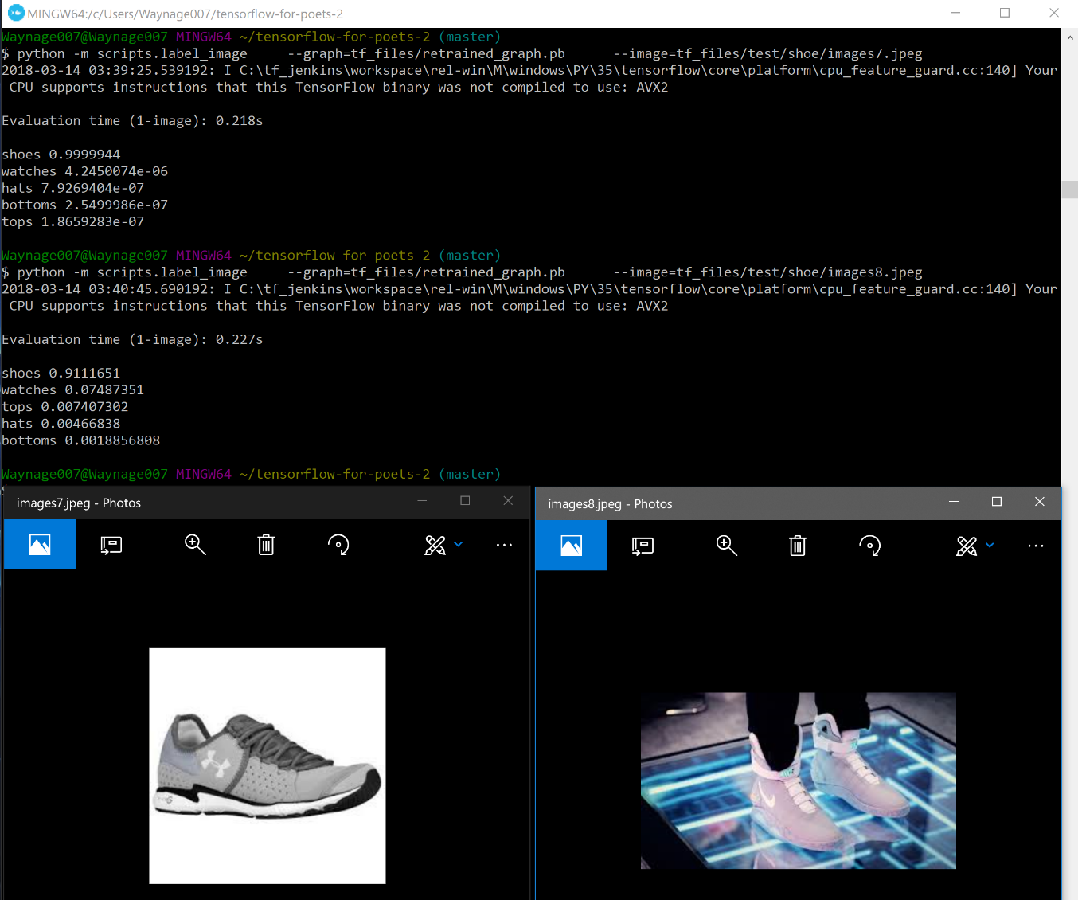
TensorFlow Deep Learning Classification
Utilization of SoftMax algorithm.
Very fast training with verification.
Classification accuracy can be very high.
Here with a catalog test image, it predicted the
shoe image (left) at 99.99%.
Even with background noise, TensorFlow
predicted the image on the right as a
shoe with 91.11% accuracy.
We will be using this algorithm for
classification.

Slide 12
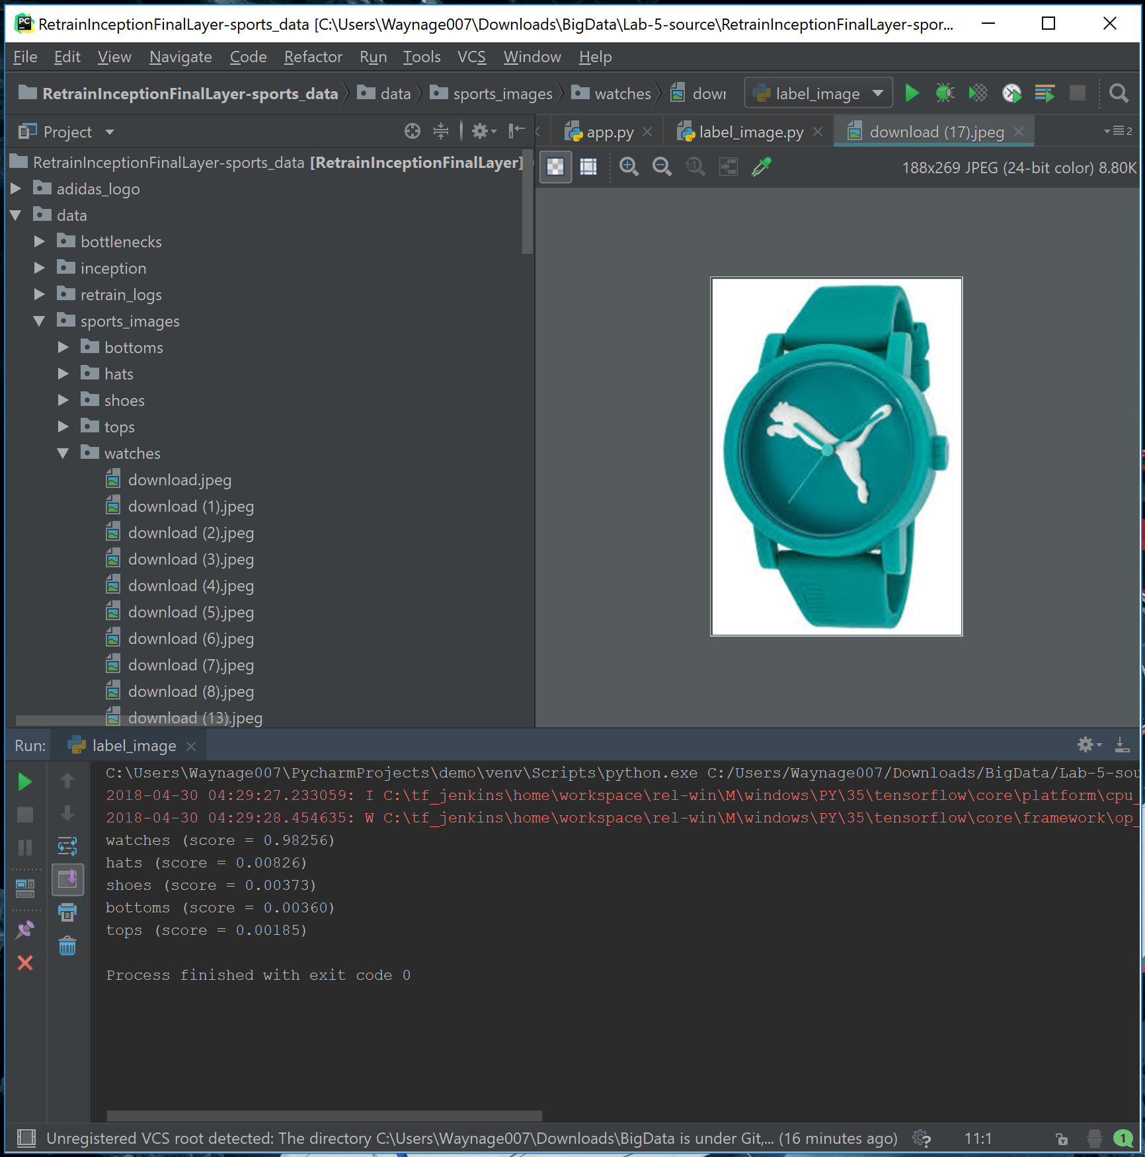
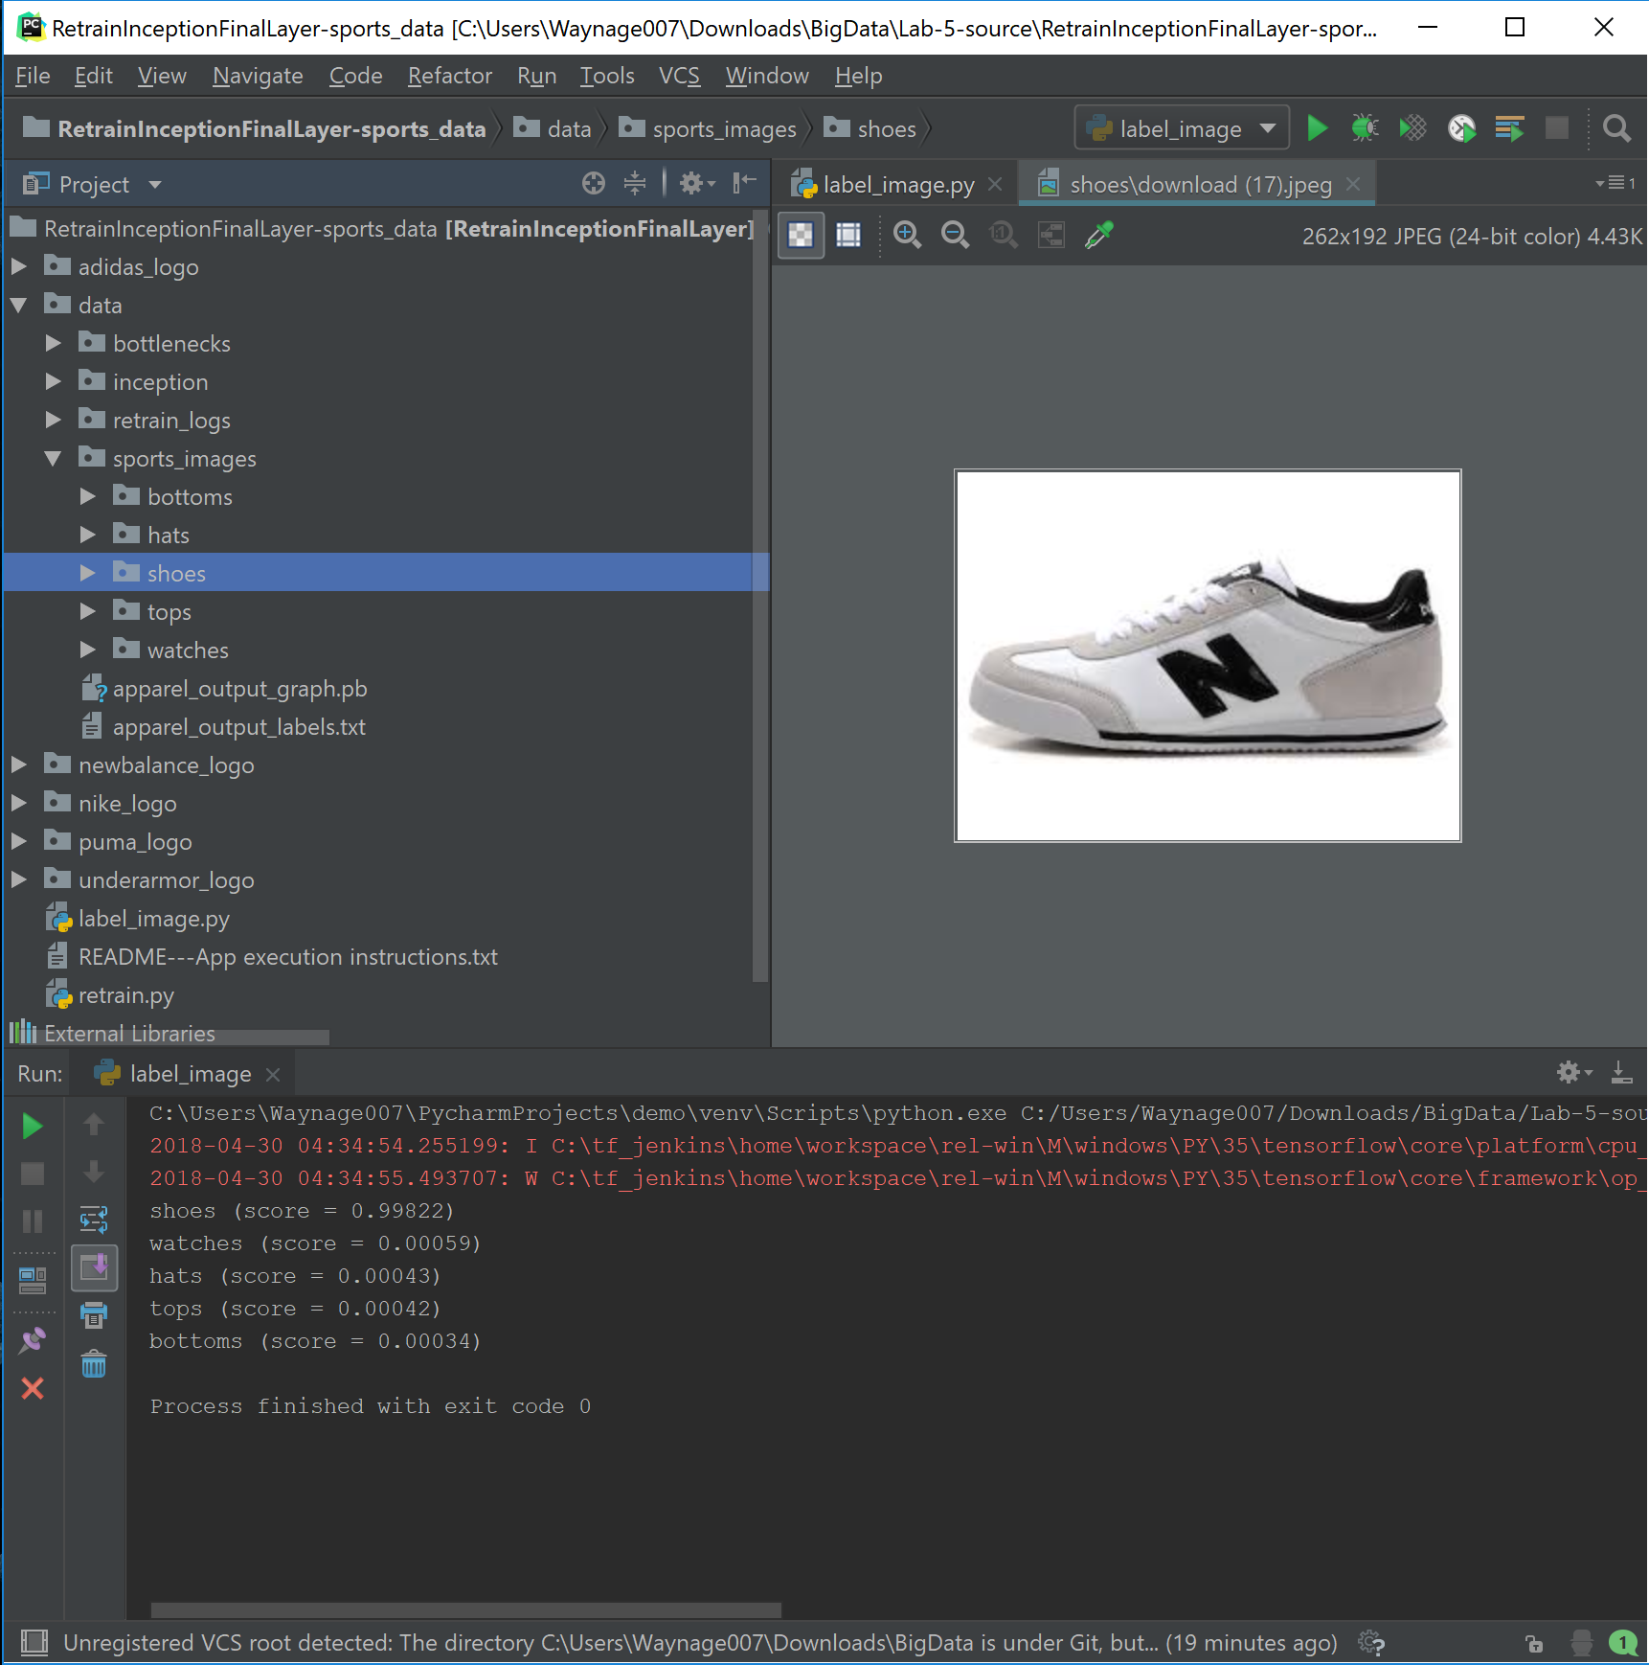

Slide 13
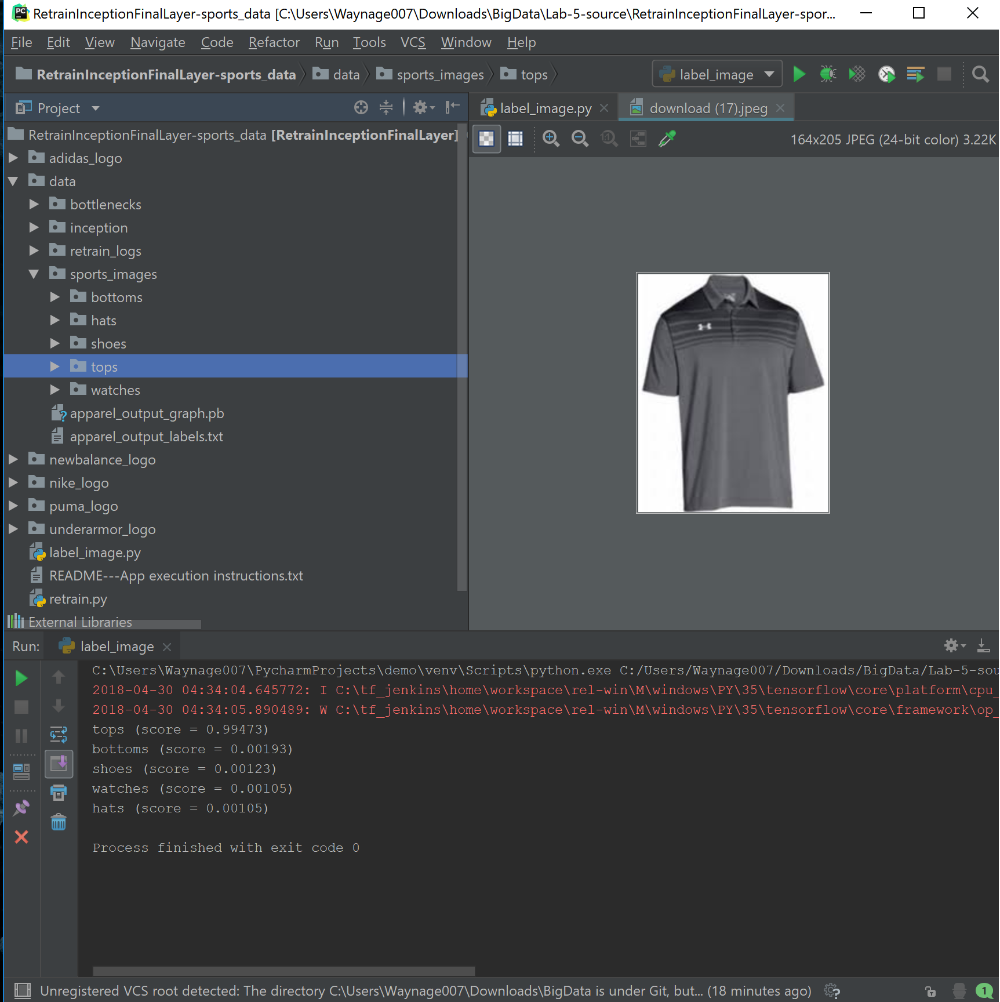
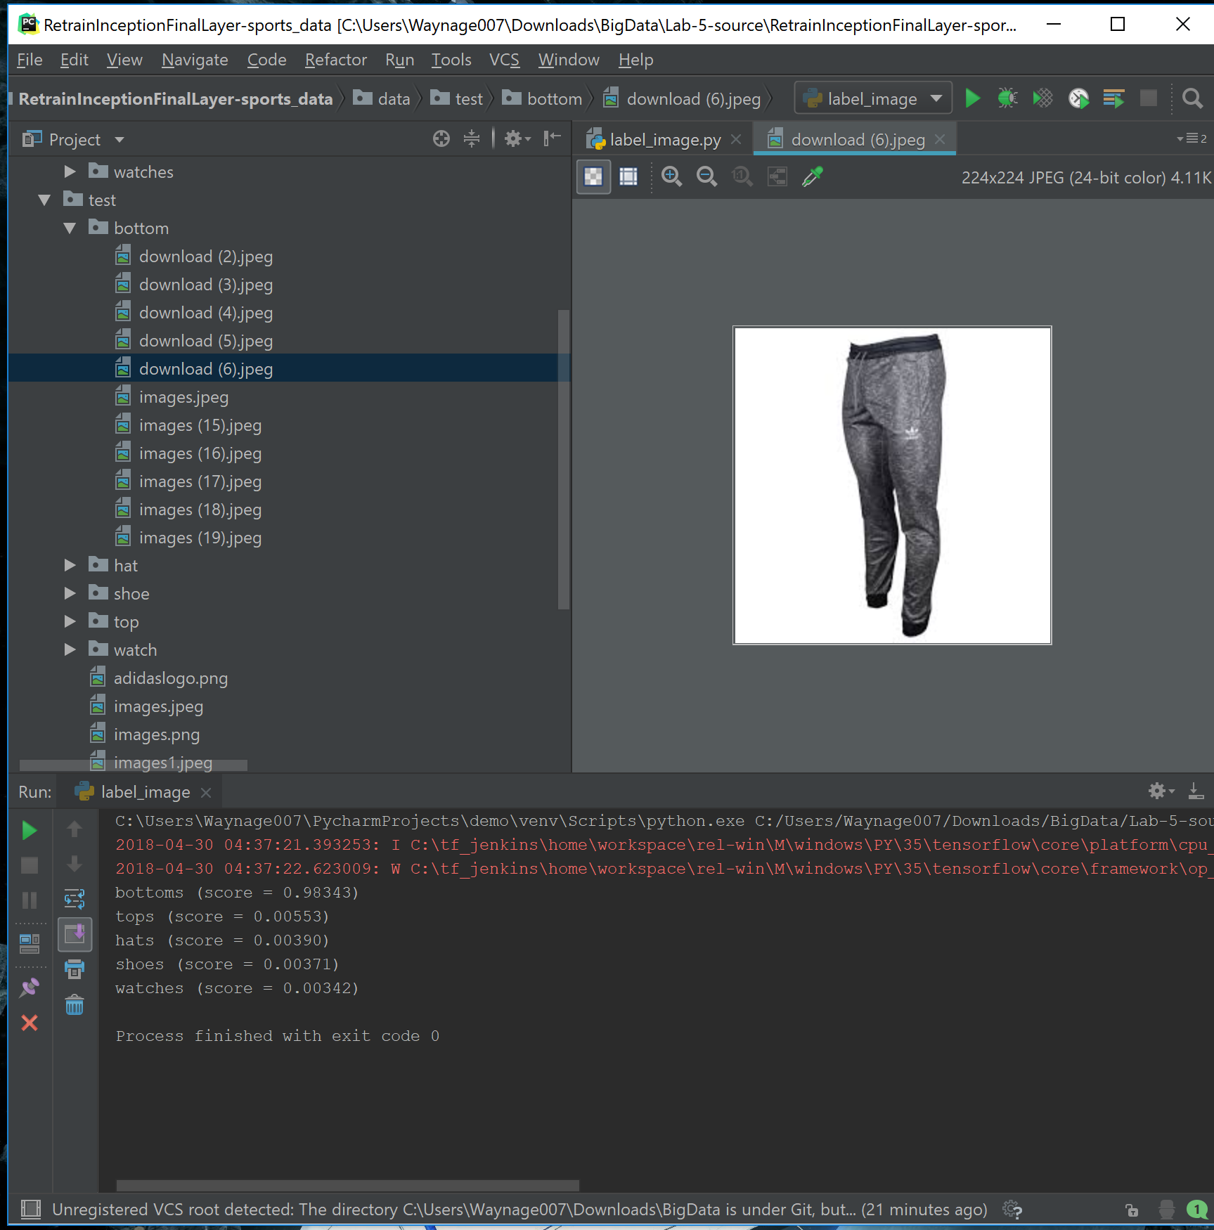

Slide 14
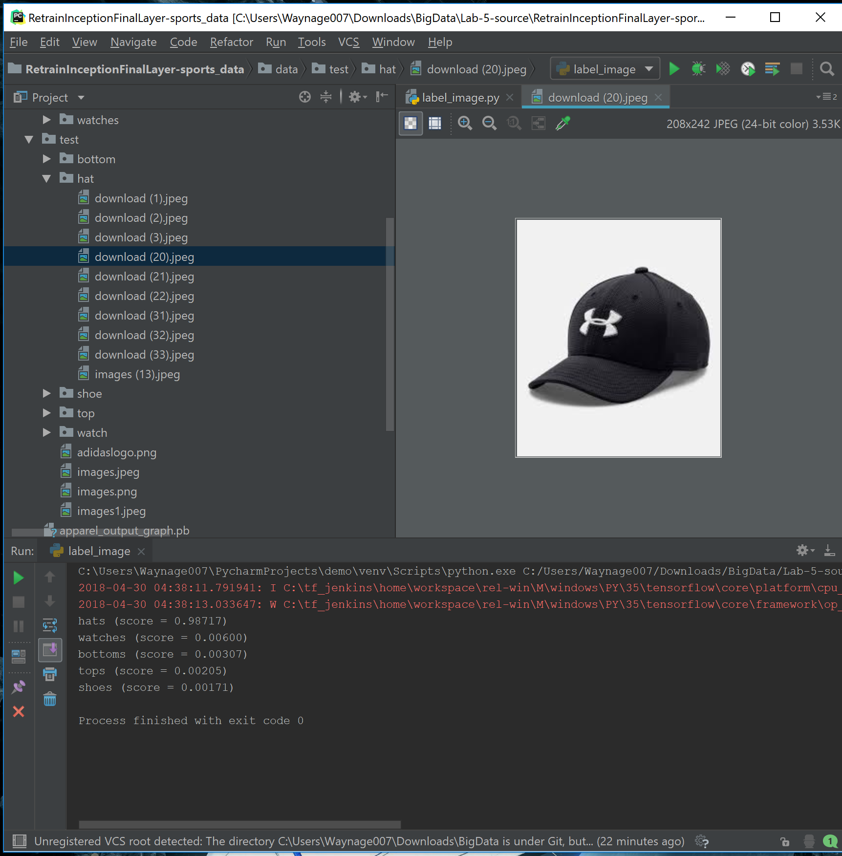

Slide 15
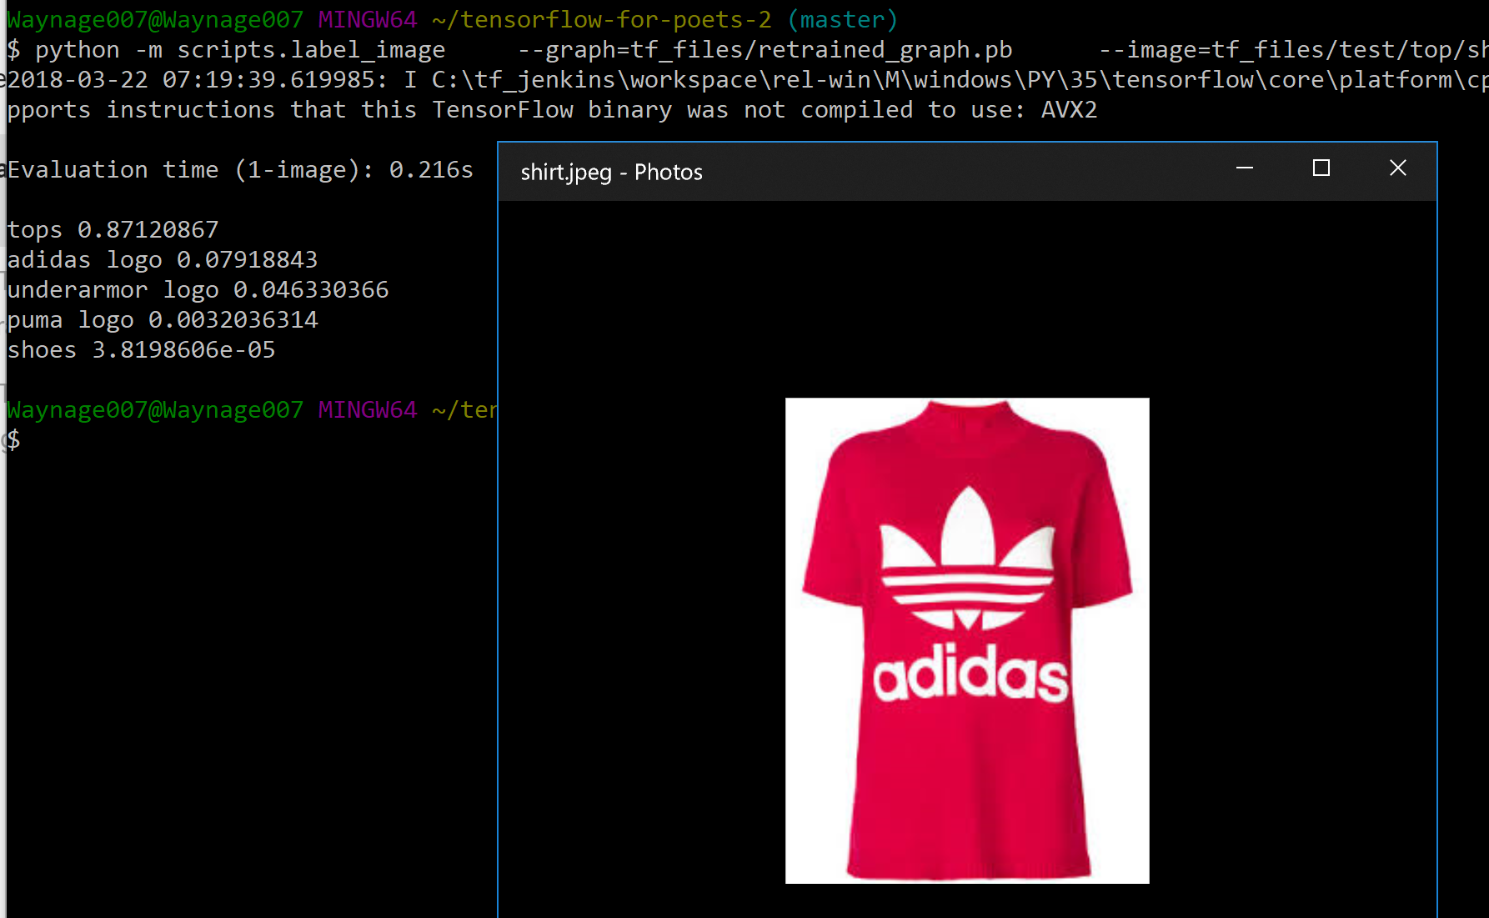
TensorFlow Deep Learning Logo Recognition
Logo detection within an image is still an issue with our project.
Here TensorFlow classified it as a top at 87.12%, but as an Adidas logo at only 7.91%
CNN algorithm might help solve this issue and will be implemented in the next increment.

Slide 16
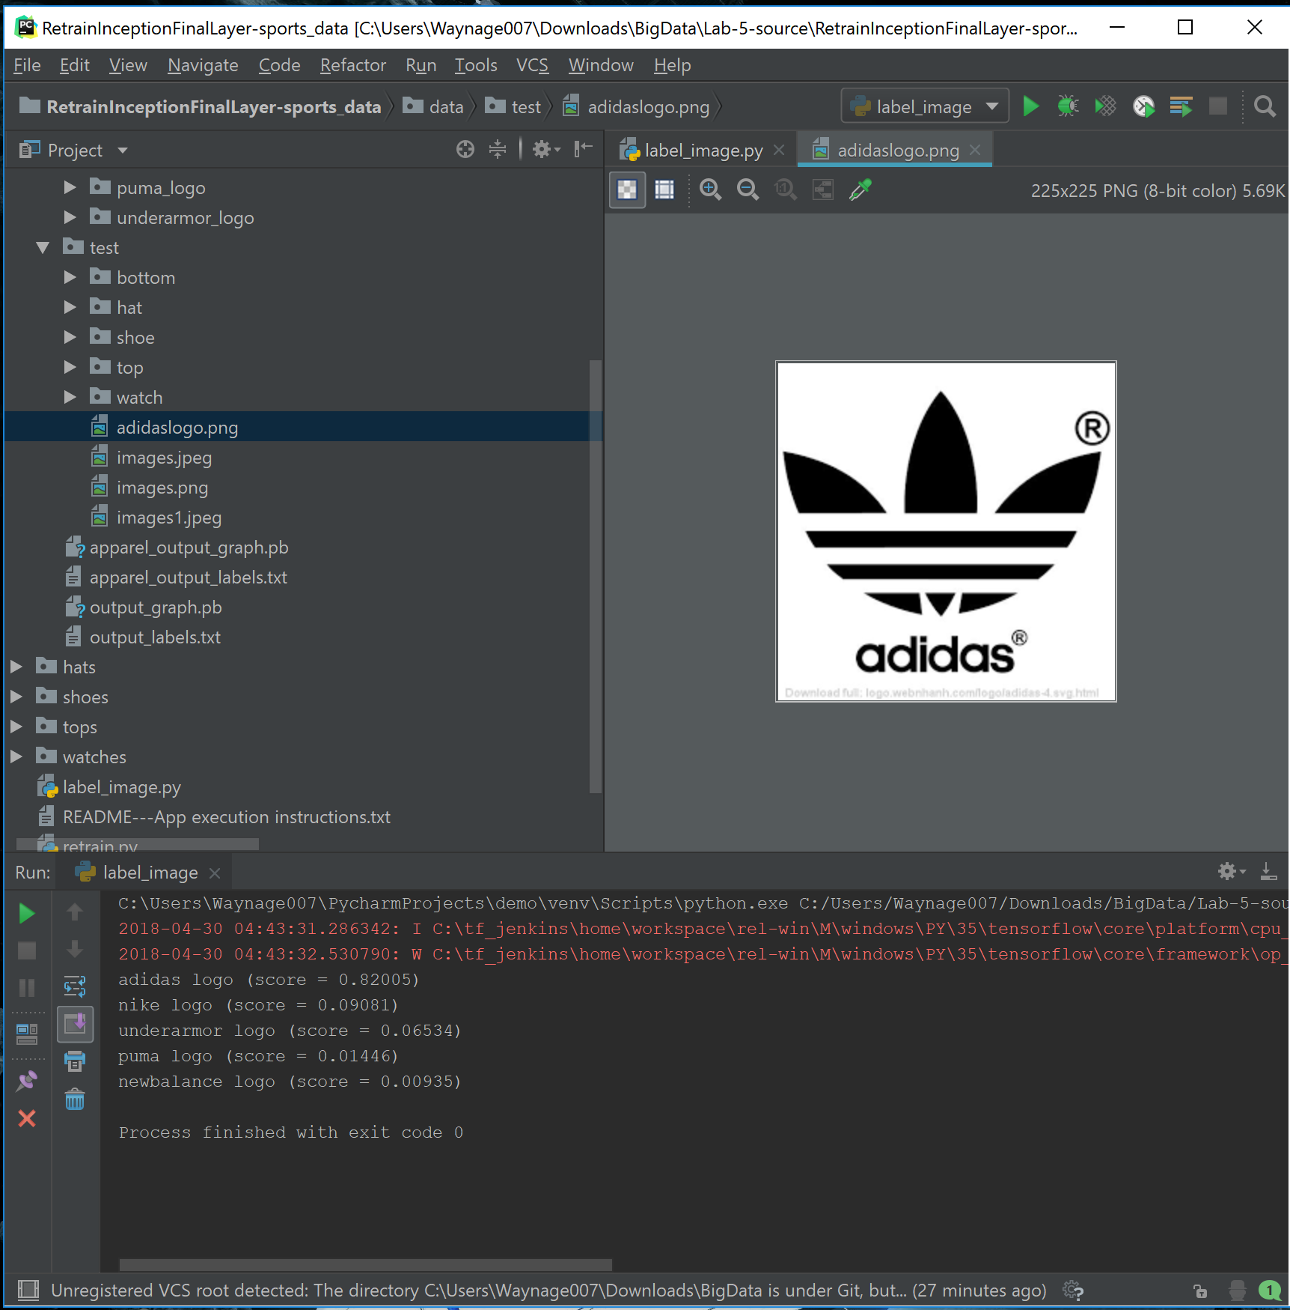
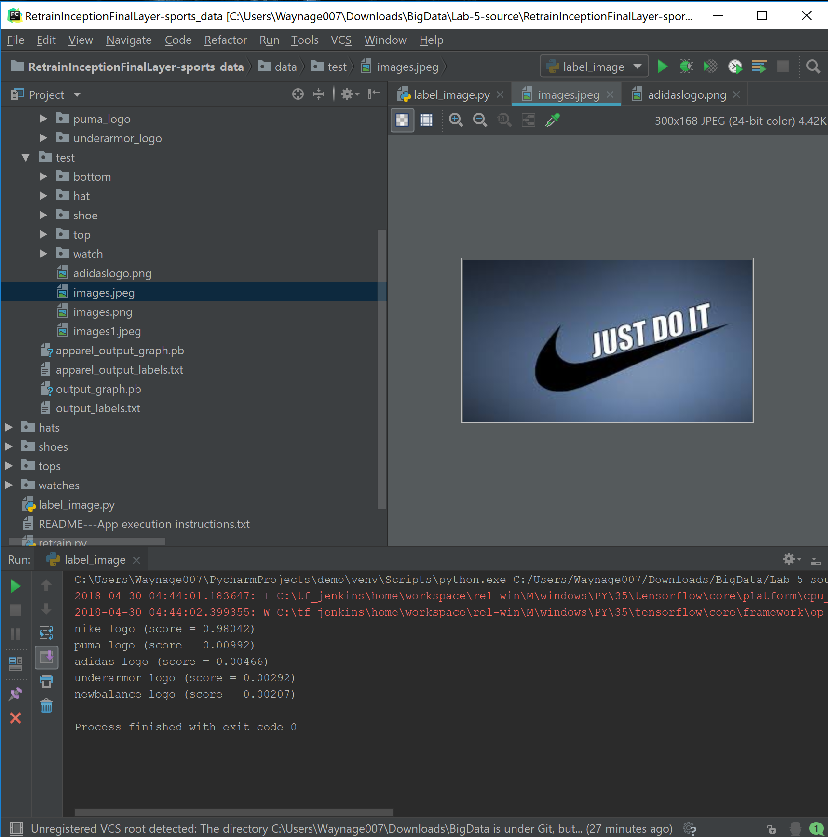

Slide 17
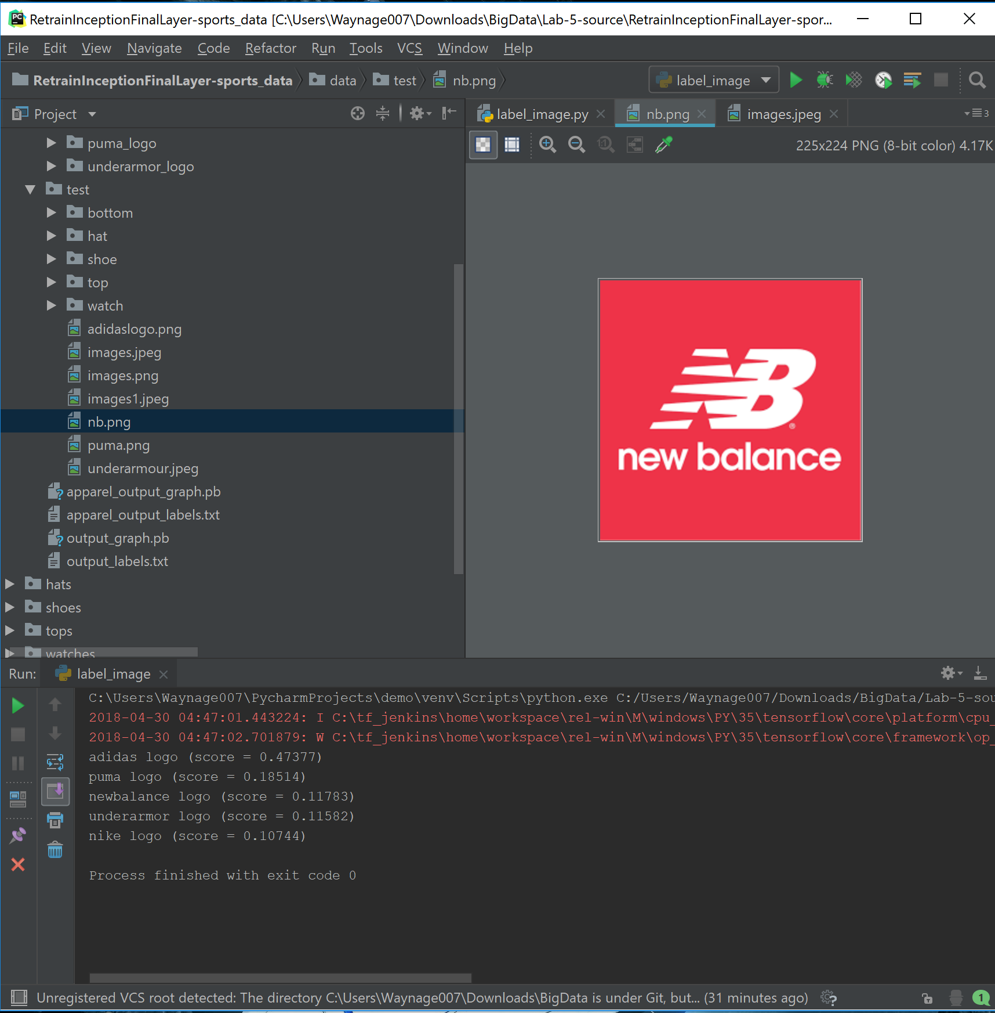
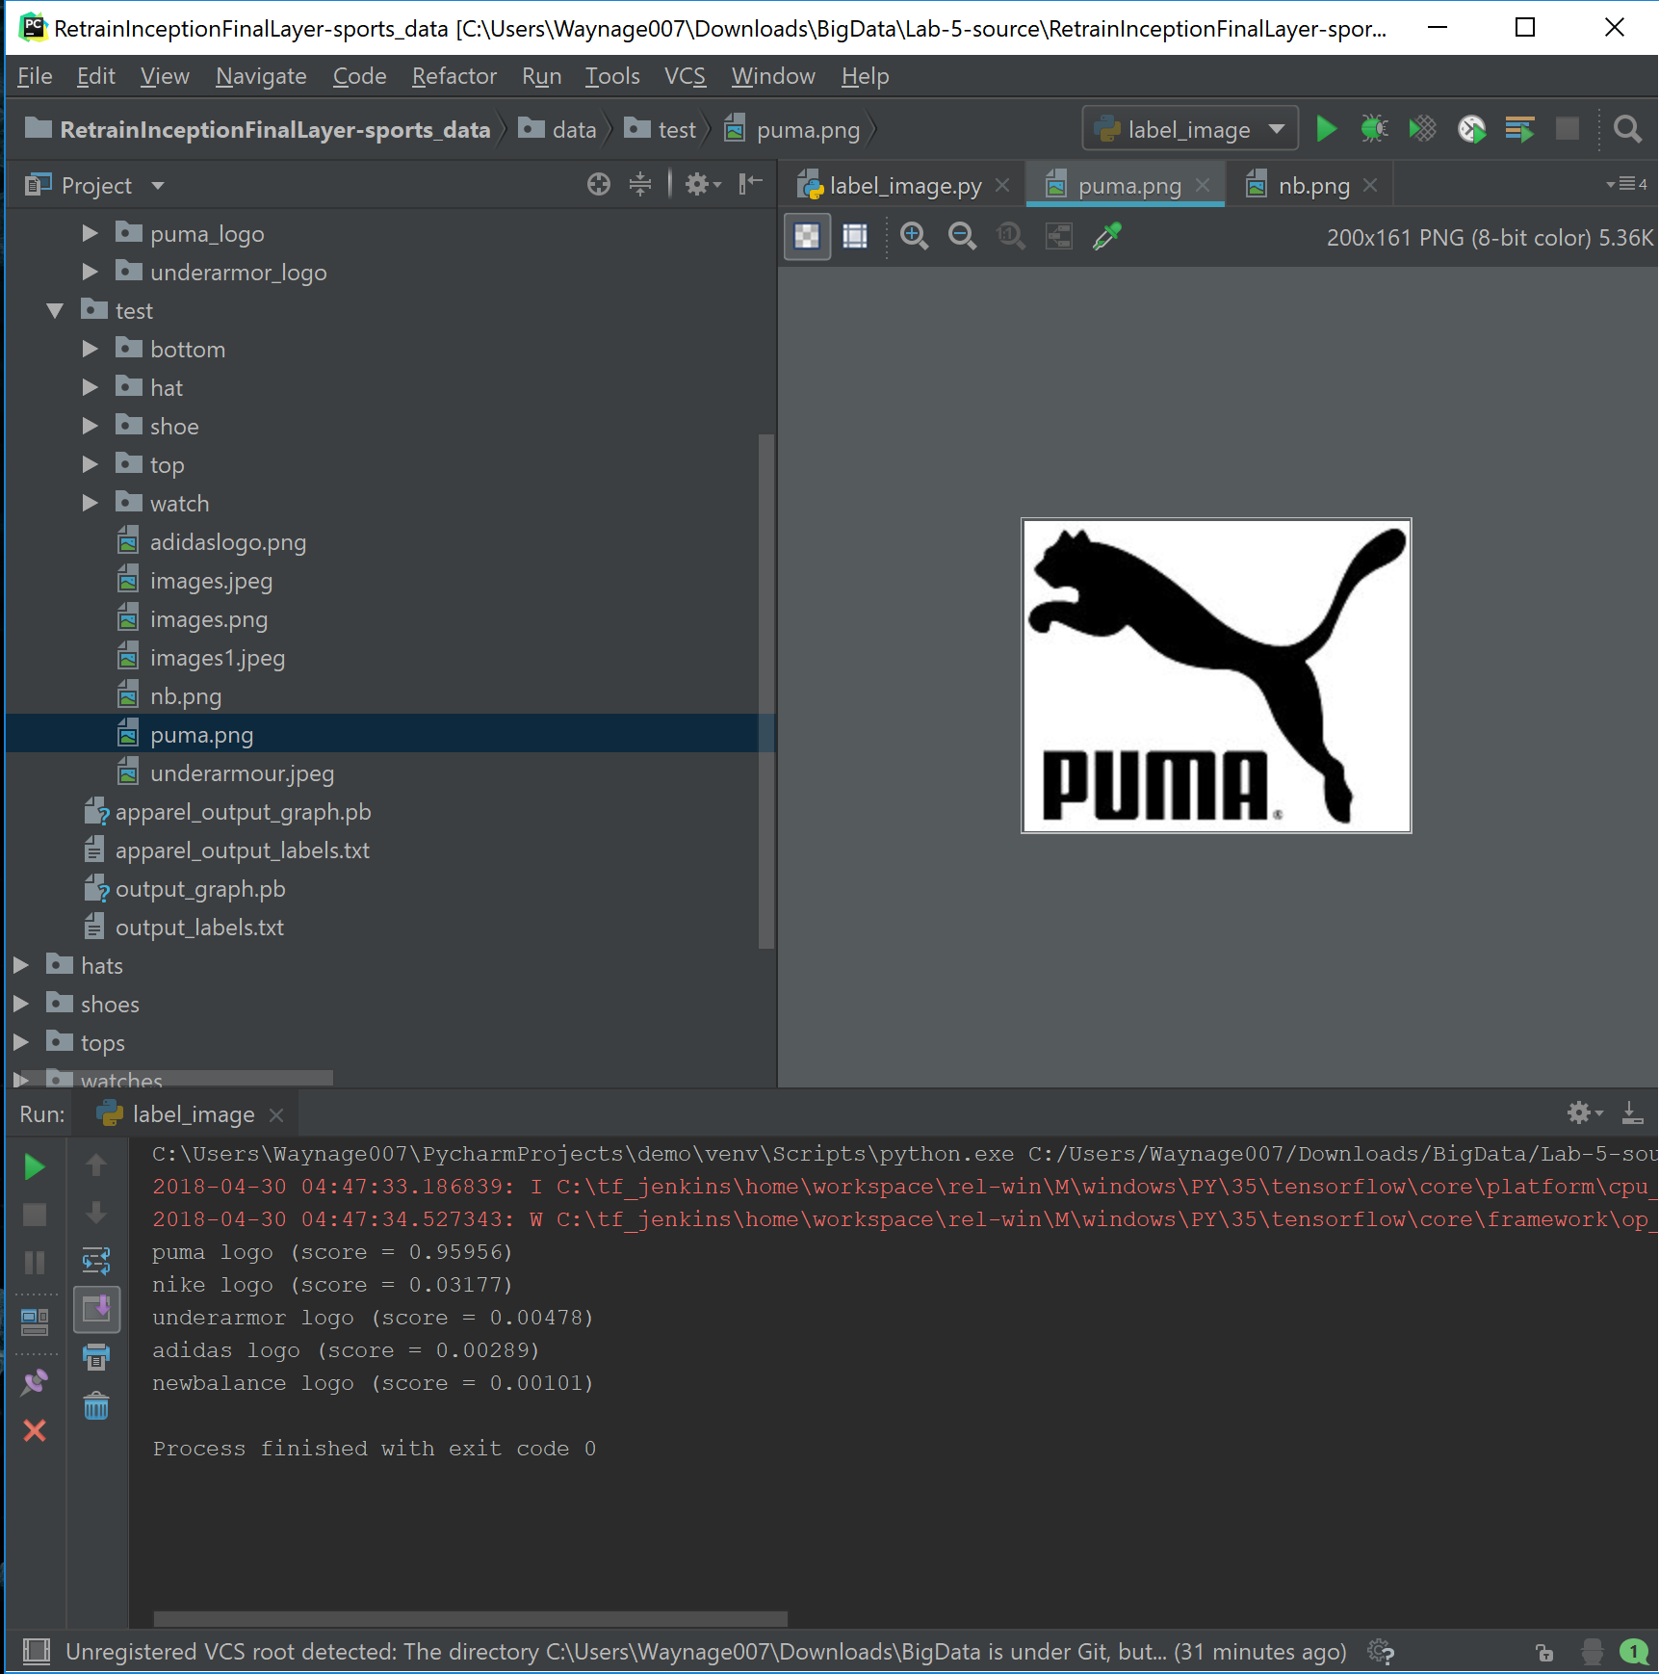

Slide 18
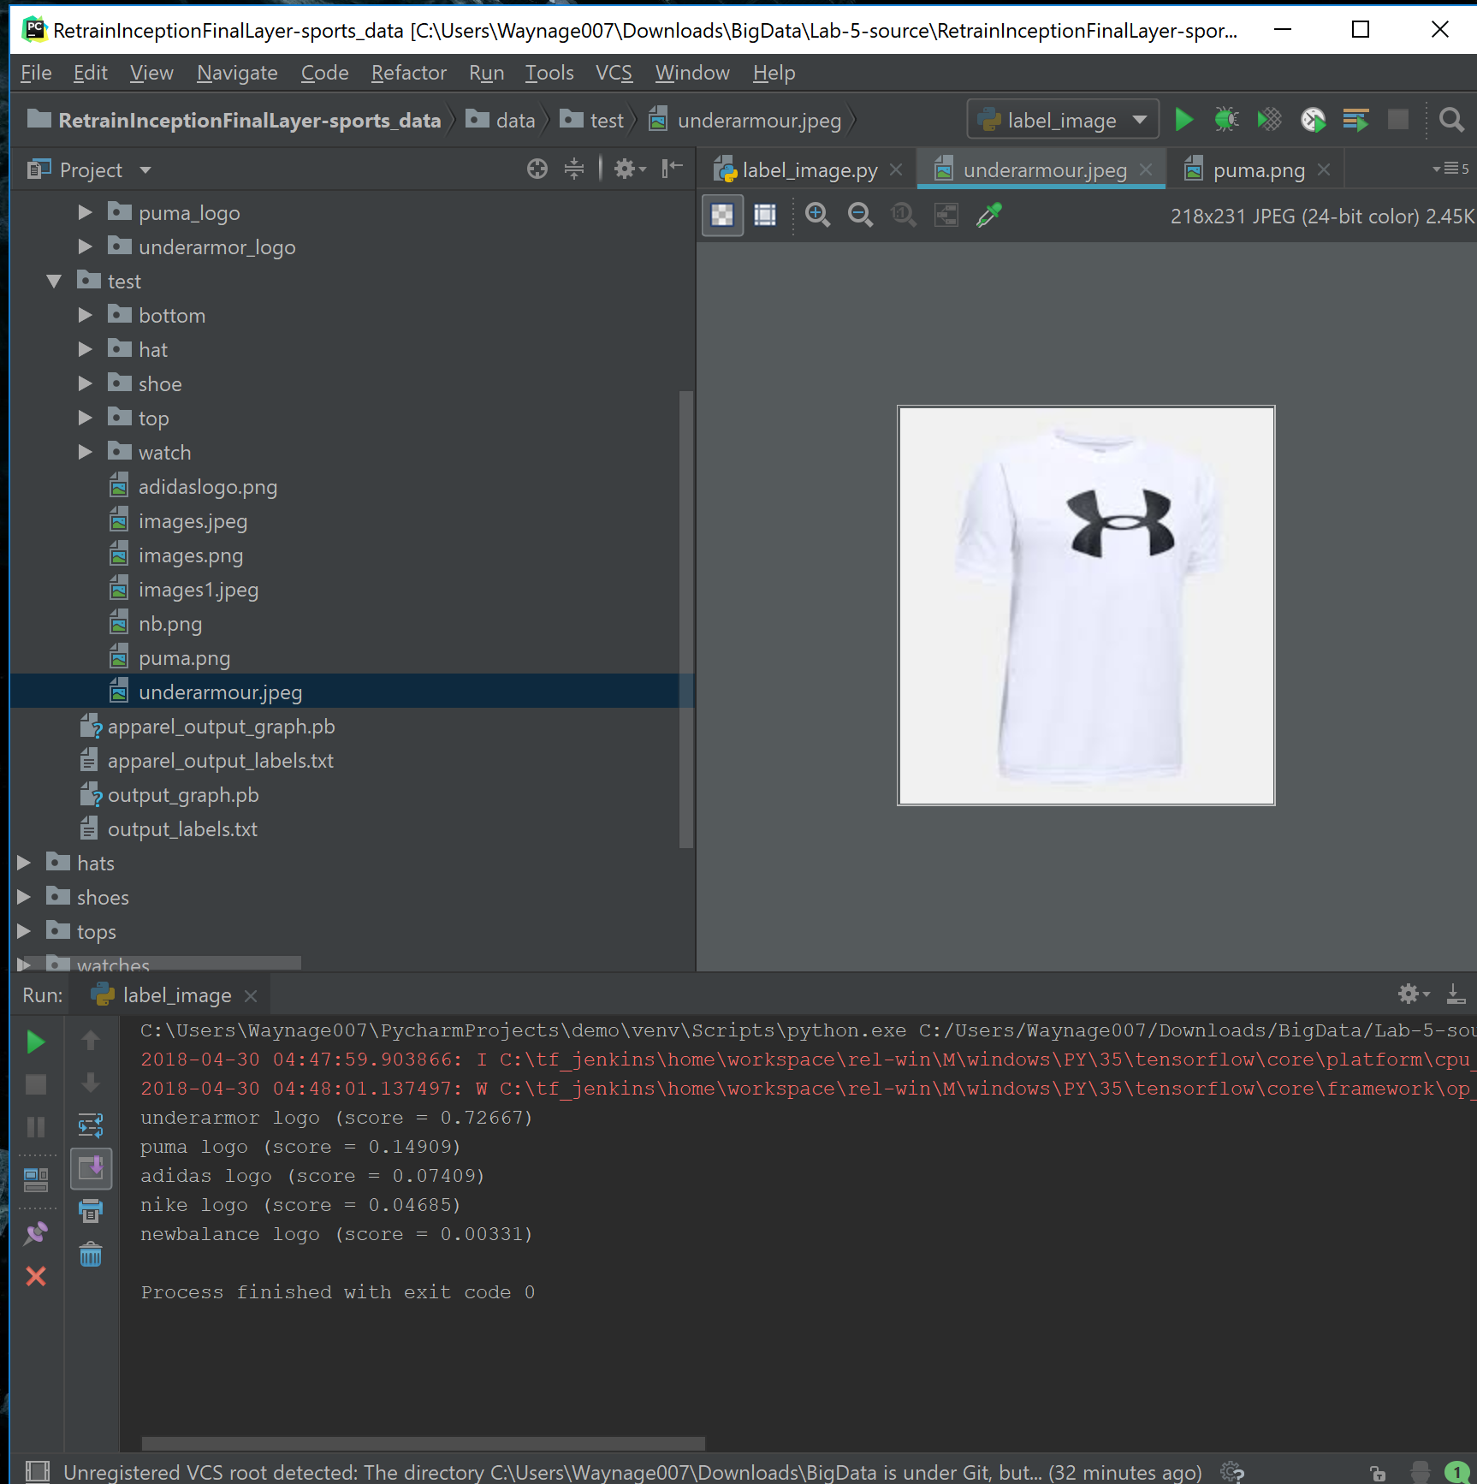

Slide 19
Thank You

